Slide 1


Docdigitizer SLA Prediction
Final Presentation
ALY6080 – Integrated Experiential Learning
Group 5
June 28, 2022
Presented By :
Akash Raj
Amryta Panda
Jeseeka Shah
Prajakta Sable
Sharon Rosary

Slide 2
Agenda
Executive Summary
Business Problem
Exploratory Data Analysis
Final Model Selection
Conclusion & Recommendation
Data Preprocessing
Dataset Preparation & Modelling

Slide 3
Executive summary
DocDigitizer is a service provider in the document processing industry using technologies such as OCR, PowerCapture, Doculator and WorldObjects
SLA breaches are very common issue faced by customer facing organizations that provide product and services. To minimize the SLA breaches, it is important to identify the factors affecting the breaches, using the attributes of the documents, customers, time of document processing, etc.
The goal of the project is to build machine learning model to predict the SLA breaches of the documents and the factors affecting the breaches in the SLA
Data set contains 7 tables having information of the documents processed for various clients of different fields from November 2021 to January 2022
Data cleaning and EDA was performed on jobs, document monitor, question table, and the cleaned data was used to build various machine learning models to predict breaches in SLA

Slide 4
PROBLEM
SLA Breach
Predicting the SLA breaches
SLA breaches are very common issue faced by customer facing organizations that provide product and services.
The important factors that influence the SLA breaches can be used to predict the high-risk document that are likely to have breaches.
Time of document processing
Cost
This refers to the time when a job is assigned to an agent till the entire document is processed within the given time frame.
The processing time of document is reduced which will intern reduce the cost.
Root cause analysis
Usability
It’s important to identify the factors that affect the breaches in the SLA of the documents.
The usability of the model will depend on the accuracy percentage. Therefore, to increase the chances of accuracy we are implementing 5 Models.

Slide 5
Data Preprocessing
Establishing Connection with AZURE
Creating Dummy Variables
Using Azure Data Studio, a connection was established with the database server to access the data. This data was then saved in csv format and then used for the project.
After careful consideration, the significant categorical values were ruled, and new dummy variables were created to be used in the models.
Removing Null Values
Number Formatting
Replacement of the null values with mean or median values in those columns. Furthermore, columns with higher null values were dropped.
Inappropriate data formats were handled and replaced with there corresponding values.

Slide 6
Exploratory Data Analysis
Identifying missing values
Analyzing time duration for document processing
Understanding the type of documents processed
Identifying documents with SLA violation
Correlation between variables for feature selection

Slide 7
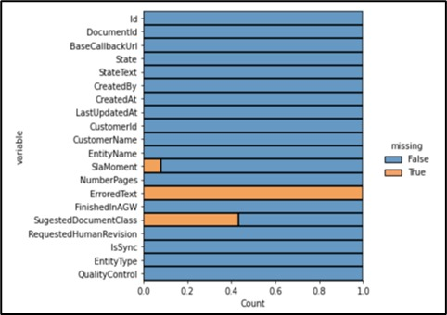
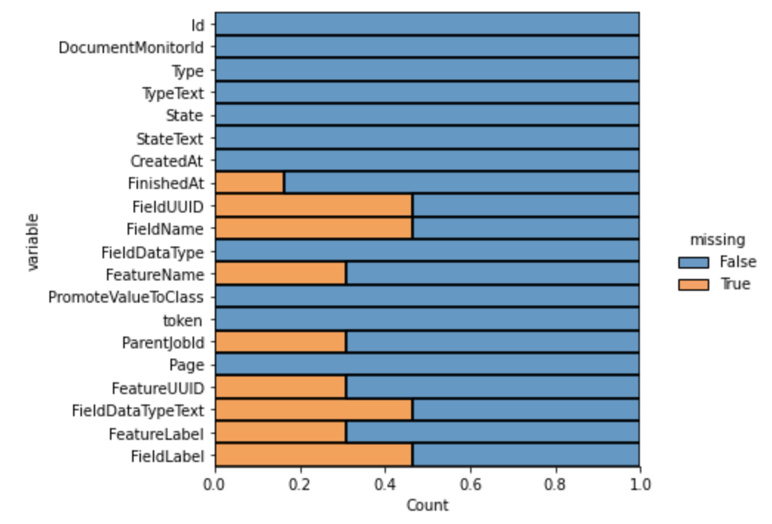
Exploratory Data Analysis
Missing values Analysis
Document Monitor Table
Job Table
The DocumentMonitor table contains 38,831 rows and 20 columns. SLAMoment variable had 1% of its values missing and ErroredText variable had 99% missing values. SuggestedDocumentClass had missing values, if they were multiple document classes present in the uploaded document.
The Job table has 3,75,218 rows and 20 columns. In total, 9 columns have missing values. FieldUUID, FieldName, FieldDataType Text, FieldLabel have 45% missing values. FeatureName, FeatureUUID, FeatureName and ParentjobId have 30% missing values. FinishedAt has around 20% missing values.

Slide 8
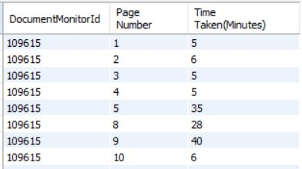
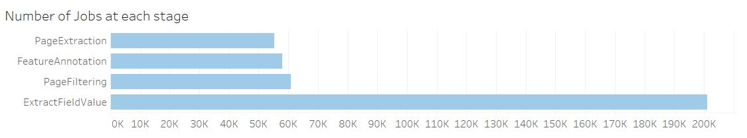
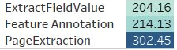
Exploratory Data Analysis
Inference from Document Monitor and Jobs Table
Time taken to process document page wise
Number of Jobs at each stage
We can infer that the field value extraction had around 200K jobs, Page filtering had 60K jobs, Feature annotation stage had less than 50K jobs.
Task wise average time calculation
While tracking the average time taken to complete each step, it was observed that Page extraction took 300 minutes whereas feature annotation and field value extraction took around 200 minutes approximately.

Slide 9
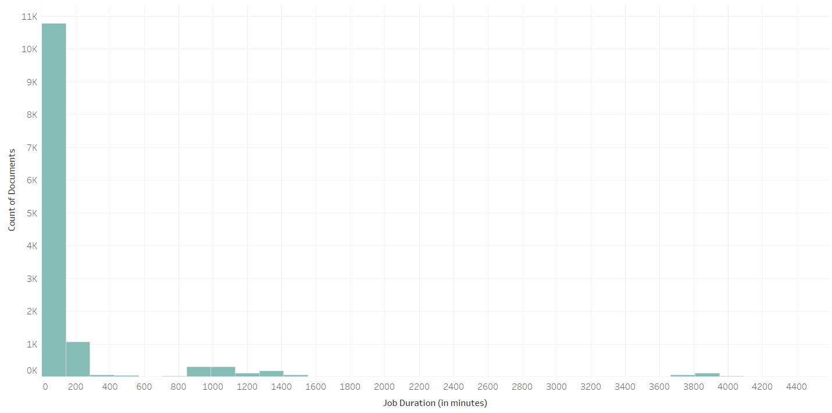
Exploratory Data Analysis
Histogram of the document processing time (Job finished time – Job created time)
Majority of the documents assigned to jobs were processed in less than 100 minutes

Slide 10
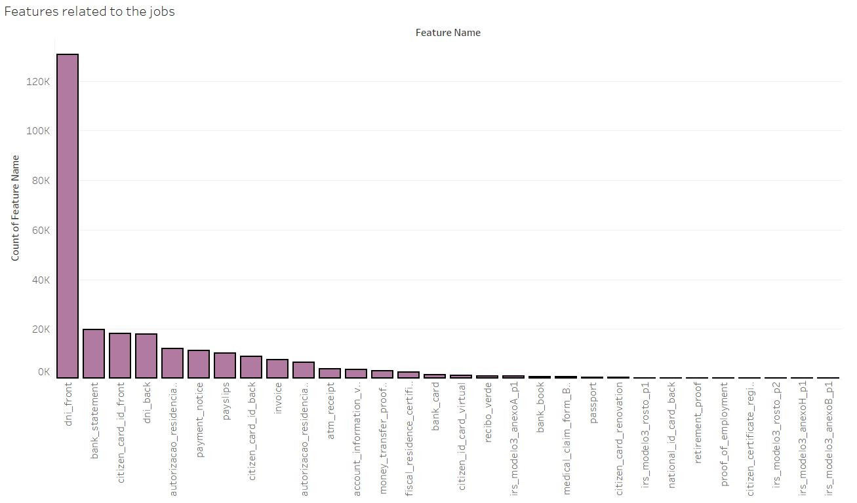
Exploratory Data Analysis
Document classes assigned to jobs
If a job relates to a feature, it can be identified by the feature name. Around 130,557 jobs were related to the DNI front feature, which is nothing but the processing of the front side of valid international travel documents. This was followed by bank statement and citizen ID card

Slide 11
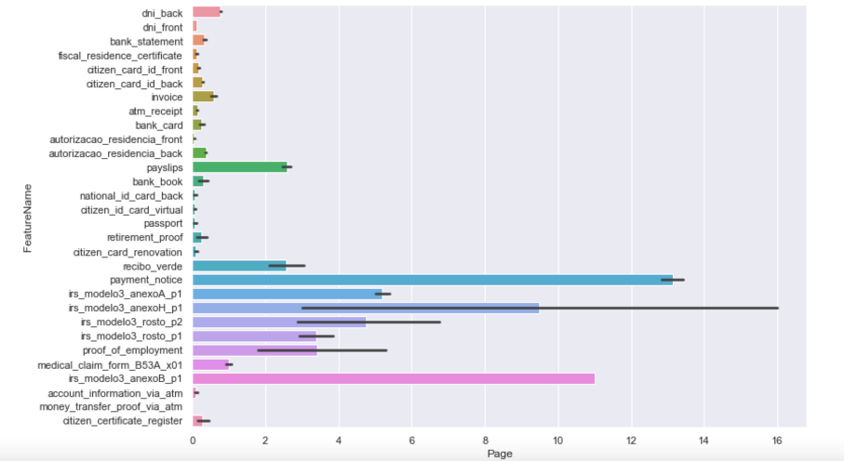
Exploratory Data Analysis
Number of pages processed per document class
Documents of type Payment notice had the maximum number of pages (0 -13 pages approx.)

Slide 12
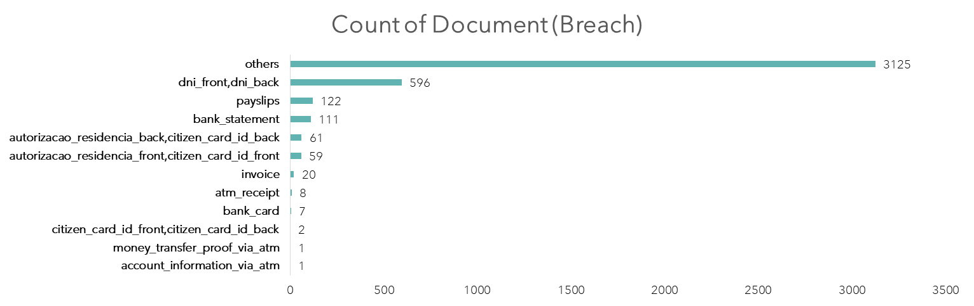
Exploratory Data Analysis
Count of SLA breaches across different document class
38,671
4,113
Number of documents
Number of SLA breaches
There were 38,671 document processed out of which ~10% had a breach in SLA

Slide 13
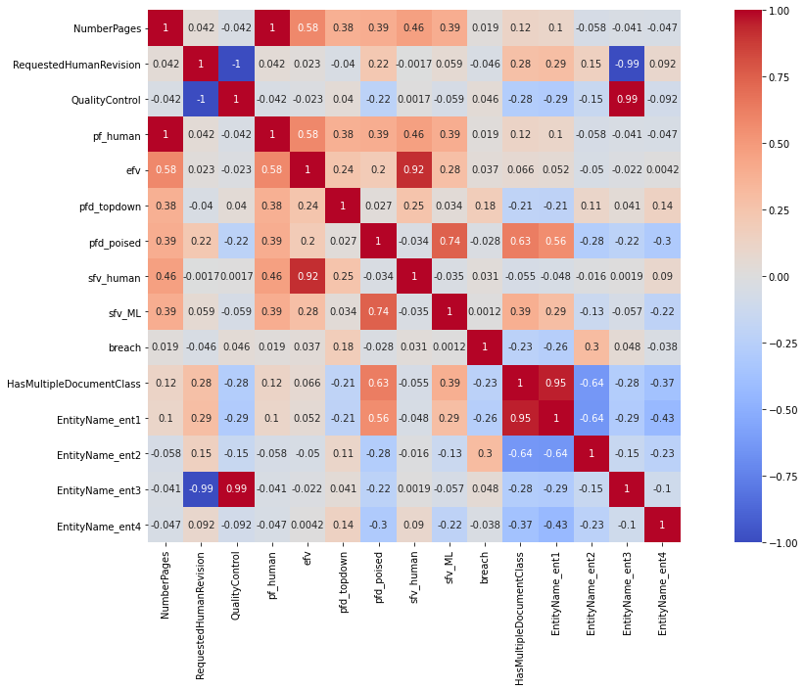
Exploratory Data Analysis
Correlation matrix of variables
The dependent variable SLA breach does not have very high correlation with any independent variable
However, SLA breach has the highest correlation with Entity 2 of 0.3, and ‘Page Feature Detection - Topdown’ question of 0.18
SLA breach is negatively correlated with ‘Entity 2’ and ‘Document Class’ with values -0.26 and -0.23 respectively
This indicates that SLA breach is less with documents from ‘Entity 1’ and in documents having multiple classes
Requested Human Revision is highly negatively correlated with ‘Entity 3’ indicating that ‘Entity 3’ requests of fewer number of revisions in the document
The variables ‘Number of pages’ is highly correlated with the number of questions, i.e., documents with higher number of pages have higher number of questions asked

Slide 14


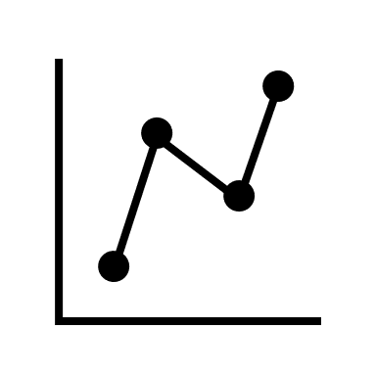
Methodology
Steps to build ML models
Data Creation
Feature Engineering
Predictive Modelling
As an initial step to modeling, data was created from document monitor, job and question tables.
Aggregated data from Document monitor and Jobs table to calculate the SLA variable.
Feature selection was performed to identify the independent variables.
The dependent variable is breach (1- breach, 0 – not breached).
Features such as document class, number of pages, type of questions, requested human revision, etc. were considered as independent variables.
The final step is to build Machine Learning models to predict the SLA breaches.
The proposed modelling techniques include:
  Logistic Regression
  Random Forest
  Decision Trees
  Support vector machines
  K- nearest neighbors
SLA Calculation:
Breach = SLA limit – job execution duration

Slide 15
Data Creation
Creating the dependent and independent variables for the models
Document Monitor
Document Monitor
Independent variables
Number of Pages
Document Class
Requested Human Revision
Quality Control
Customer Name
Types of Questions
SLA Breach
Questions
Jobs
Jobs

Slide 16
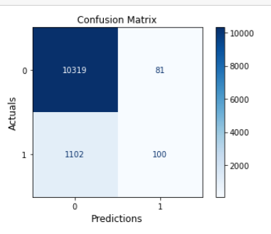
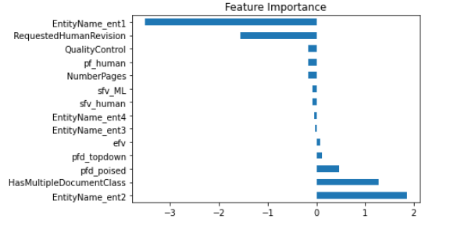
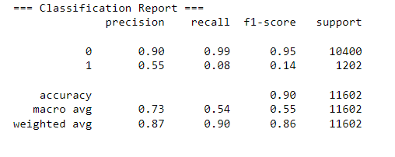
ML Models
Logistic Regression
Accuracy of logistic regression being 90 percent, precision for no SLA breach is 0.99 and for SLA breach comes to 0.55. The table shows all the other parameters that were considered towards finalizing the model
Page feature detection -Poised , HasMultipleDocumentClass, EnityNamw_ent2 are the feature that are accountable for getting such good accuracy of the model

Slide 17
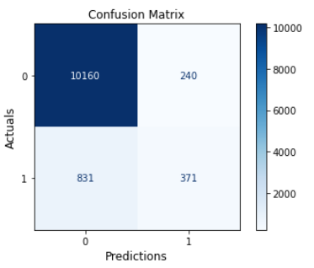
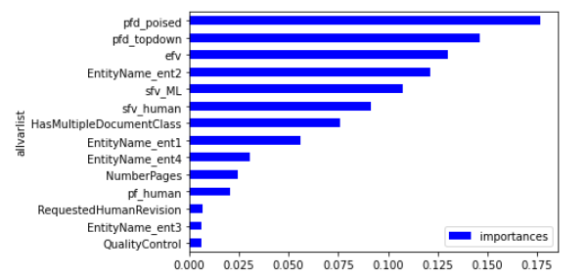
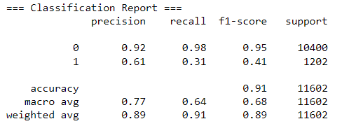
ML Models
Random Forest
The model had an accuracy of 91% with a precision value of 0.89 and recall value of 0.91
The three most important features that can be considered accountable for this model are Page feature detection - Poised, Page feature detection - top down and extract field values

Slide 18
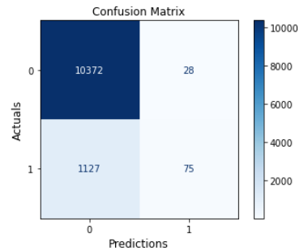
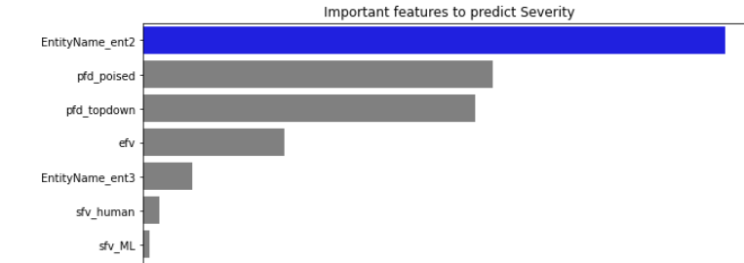
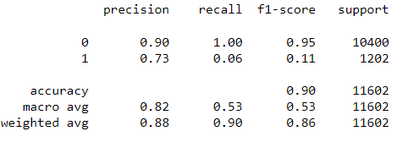
ML Models
Decision Trees
The model had an accuracy of 90% with a precision value of 0.88 and recall value of 0.90
The three most important features that can be considered accountable for this model are Entity Name – entity 2 , Page feature detection – Poised and Page feature detection - top down.

Slide 19
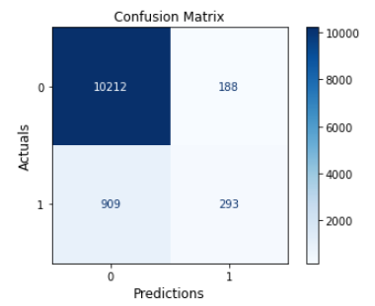
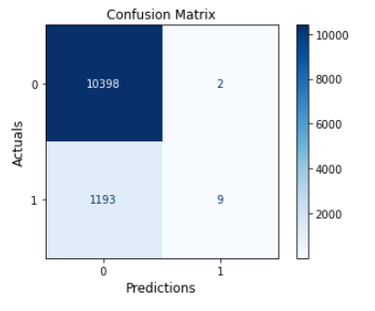
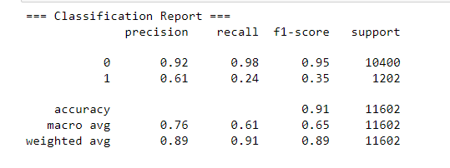
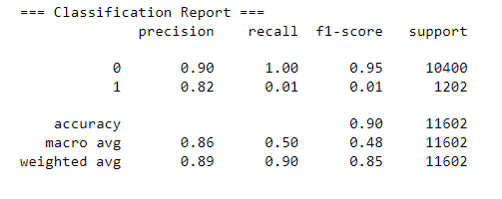
ML Models
KNN & SVM
K Nearest Neighbor Model Results
Support Vector Machine Model Results
The table above shows the metric for both KNN and SVM having accuracies as 91 % and 90 % respectively.

Slide 20
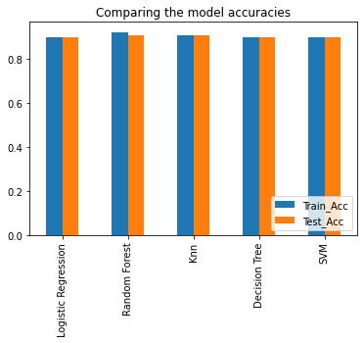
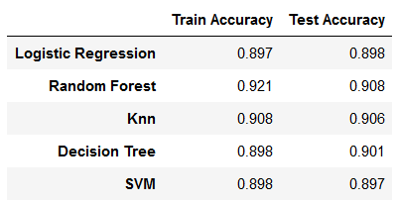
ML Models
Model Comparison & Final model selection
All the model have similar validation accuracy; Since, Random Forest has the highest test accuracy of ~91%, it will be the final model for SLA predictions

Slide 21





Conclusion & Recommendations
Out of the five ML models built, Random Forest was the best model for predicting SLA violations with an accuracy of ~91%
The number and types of questions asked are the important factors that affect SLA breach
Documents with ‘Page feature detection – Poised’, ‘Page feature detection - top down’ and ‘extract field values’ questions are more likely to have SLA breach
This model can be deployed in DocDigitizer’s production server, and can be used to predict SLA breaches of documents in real time
Further efforts can be put in to optimize the model, and reduce the number of false negatives

Slide 22
References
W. (2022, June 27). DocDigititzer - Automate Data Capture. Docdigitizer. Retrieved June 28, 2022, from https://www.docdigitizer.com/
Koehrsen, W. (2019, December 11). Random Forest in Python - Towards Data Science. Medium. Retrieved June 28, 2022, from https://towardsdatascience.com/random-forest-in-python-24d0893d51c0
Gouryraj, S., Kataria, S., & Swvigaradoss, J. (2021). Service Level Agreement Breach Prediction in ServiceNow. 2021 Third International Conference on Inventive Research in Computing Applications (ICIRCA). https://doi.org/10.1109/icirca51532.2021.9544916
Gong, D. (2022, March 23). Top 6 Machine Learning Algorithms for Classification. Medium. Retrieved June 28, 2022, from https://towardsdatascience.com/top-machine-learning-algorithms-for-classification-2197870ff501

Slide 23
THANK YOU

